Slide 1
NAAN MUDHALVAN
SALESFORCE PROJECT REPORT
COLLEGE : SCAD ENGINEERING COLLEGE,CHERANMAHADEVI
BATCH-8
NAME | NM ID | REG NO
MAHARAJA M | F3A114CBC8BC3BE8D704947D39300818 | 952820114543
MUGESHWARAN E | 8A8E95EAD643011AB4348393A55B06D5 | 952820114551
PRAKASH M | 9C54DBFF8D8599389094A4BEBBD39748 | 952820114559
SURIYA M | 0D398A9BDE4377999BF40D09926A64F7 | 952820114567
VIKRAM M | 3E134DF53FD58DCB34D44592A7075E25 | 952820114575

Slide 2
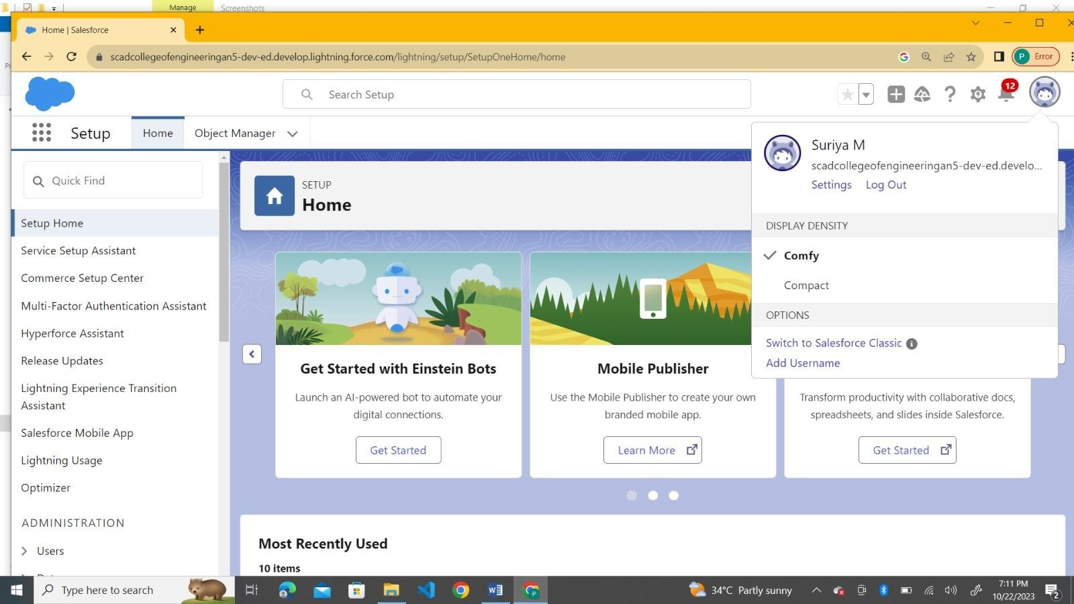
Step 1: Create Salesforce Account

Slide 3
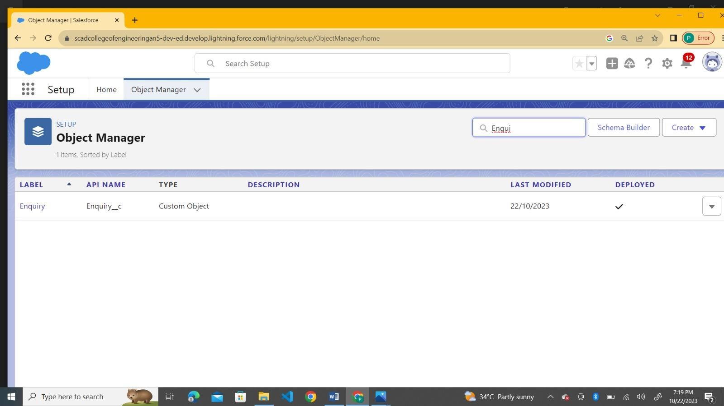
Step 2:Create the Objects (Enquiries,Properties,Loans)

Slide 4
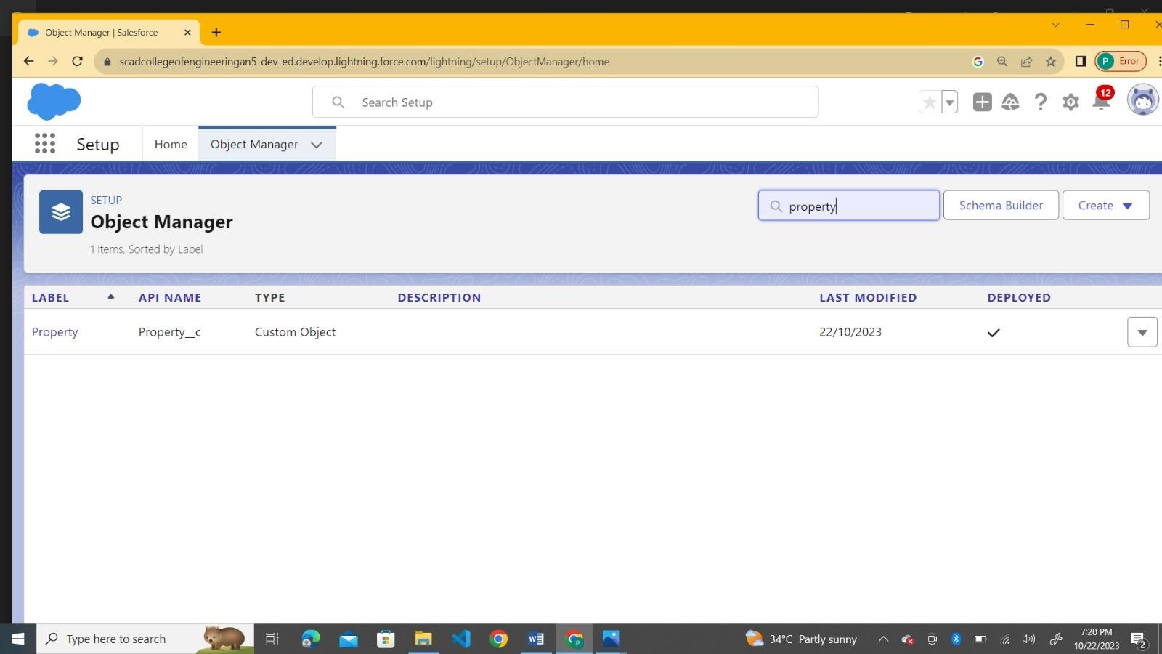

Slide 5


Slide 6
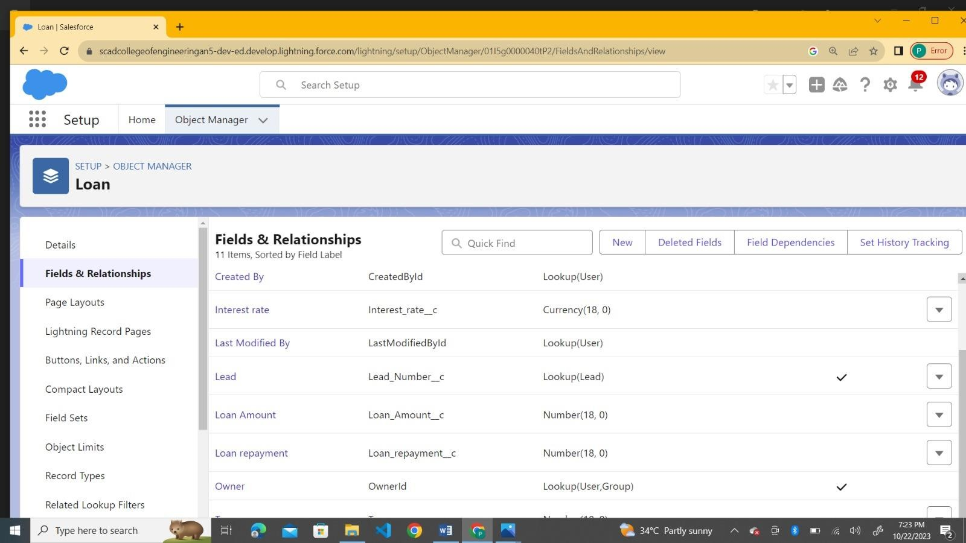
Step 3:Create Fields for Respective Object(Enquiry,Property,Loan)

Slide 7
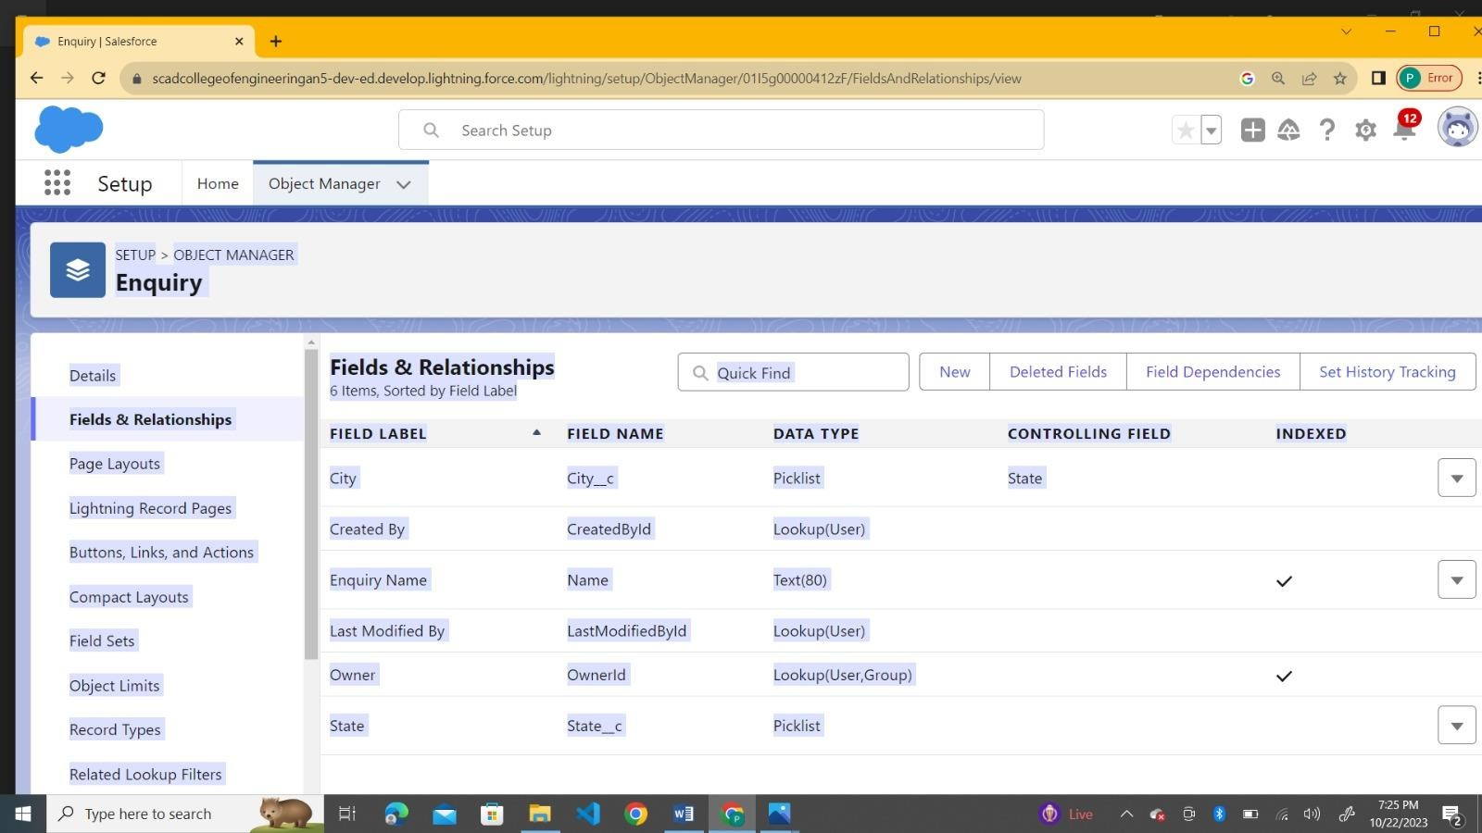

Slide 8
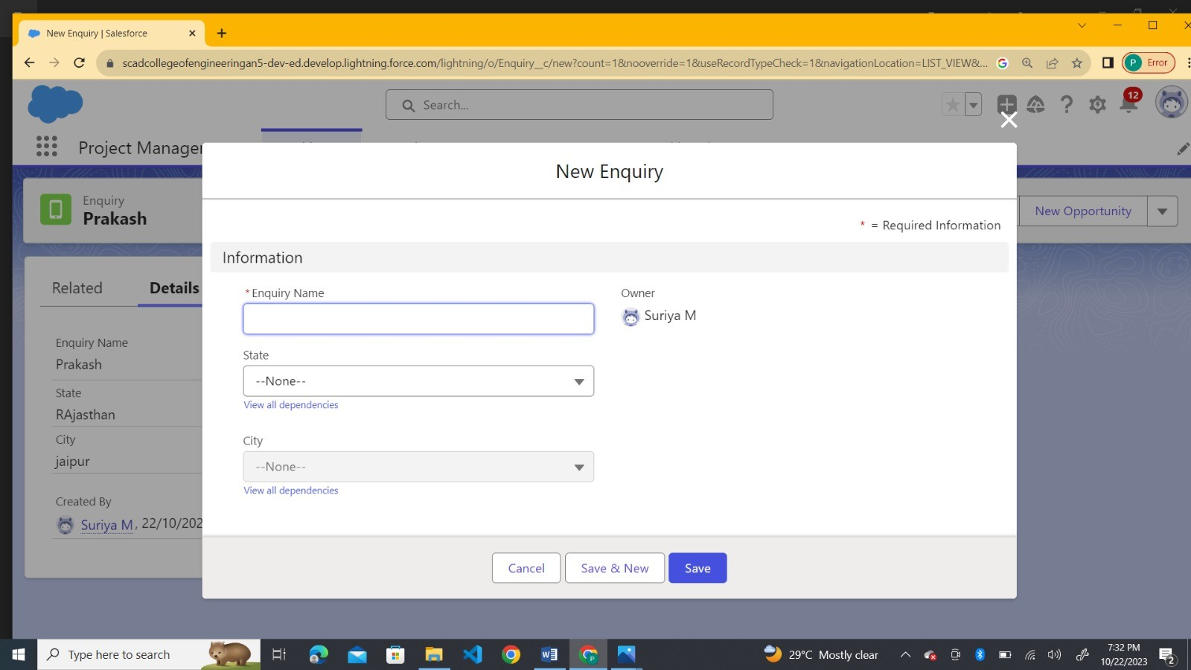

Slide 9
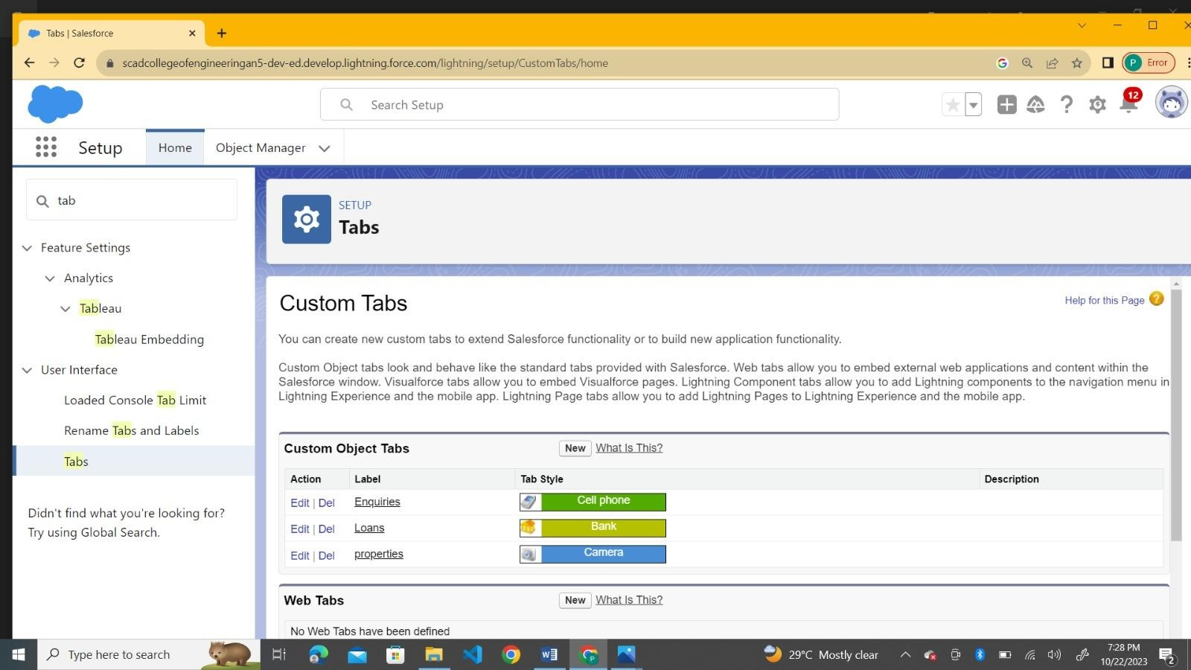
Step 4:Create the tap for each object(Enquiry,Property,Loan)

Slide 10
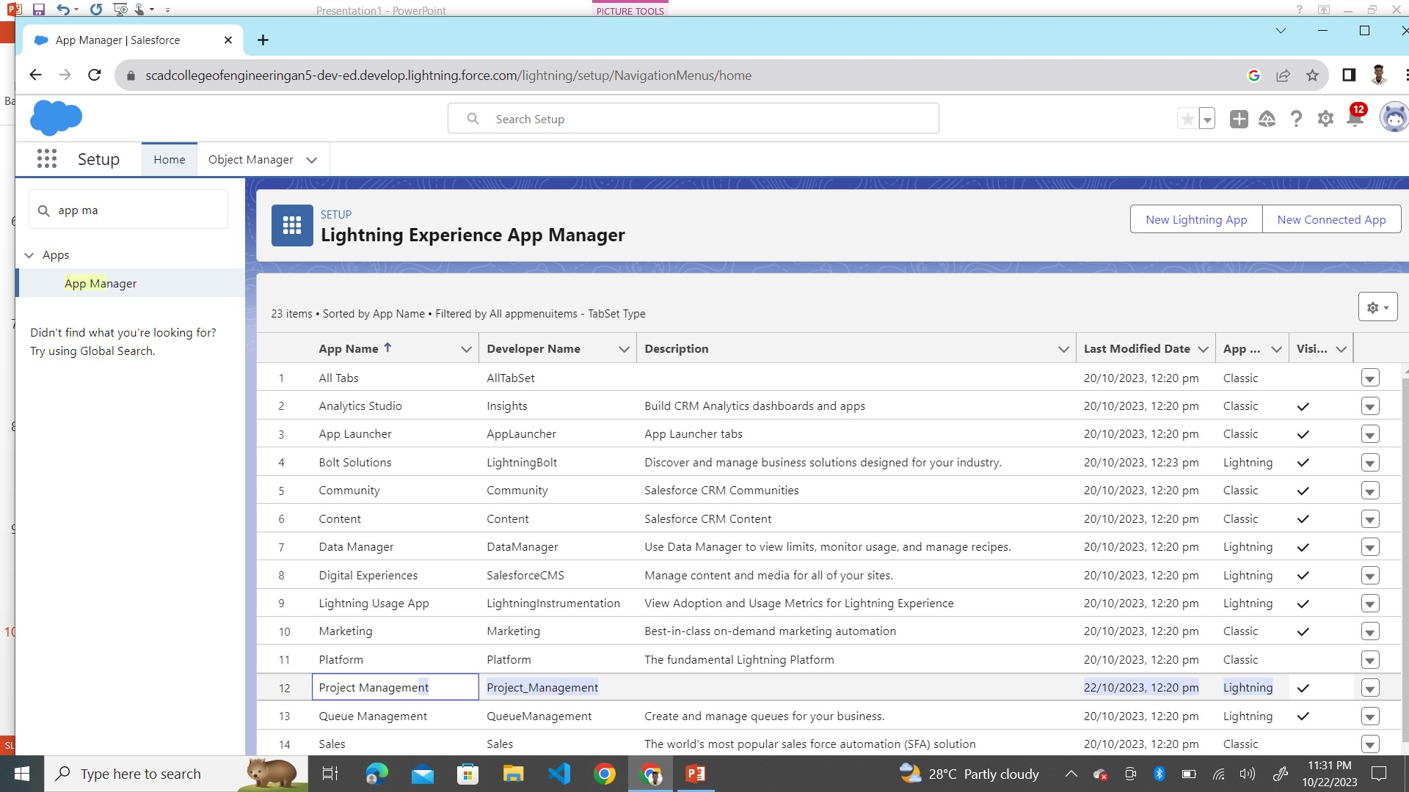
Step 5: Create a Lightning App

Slide 11
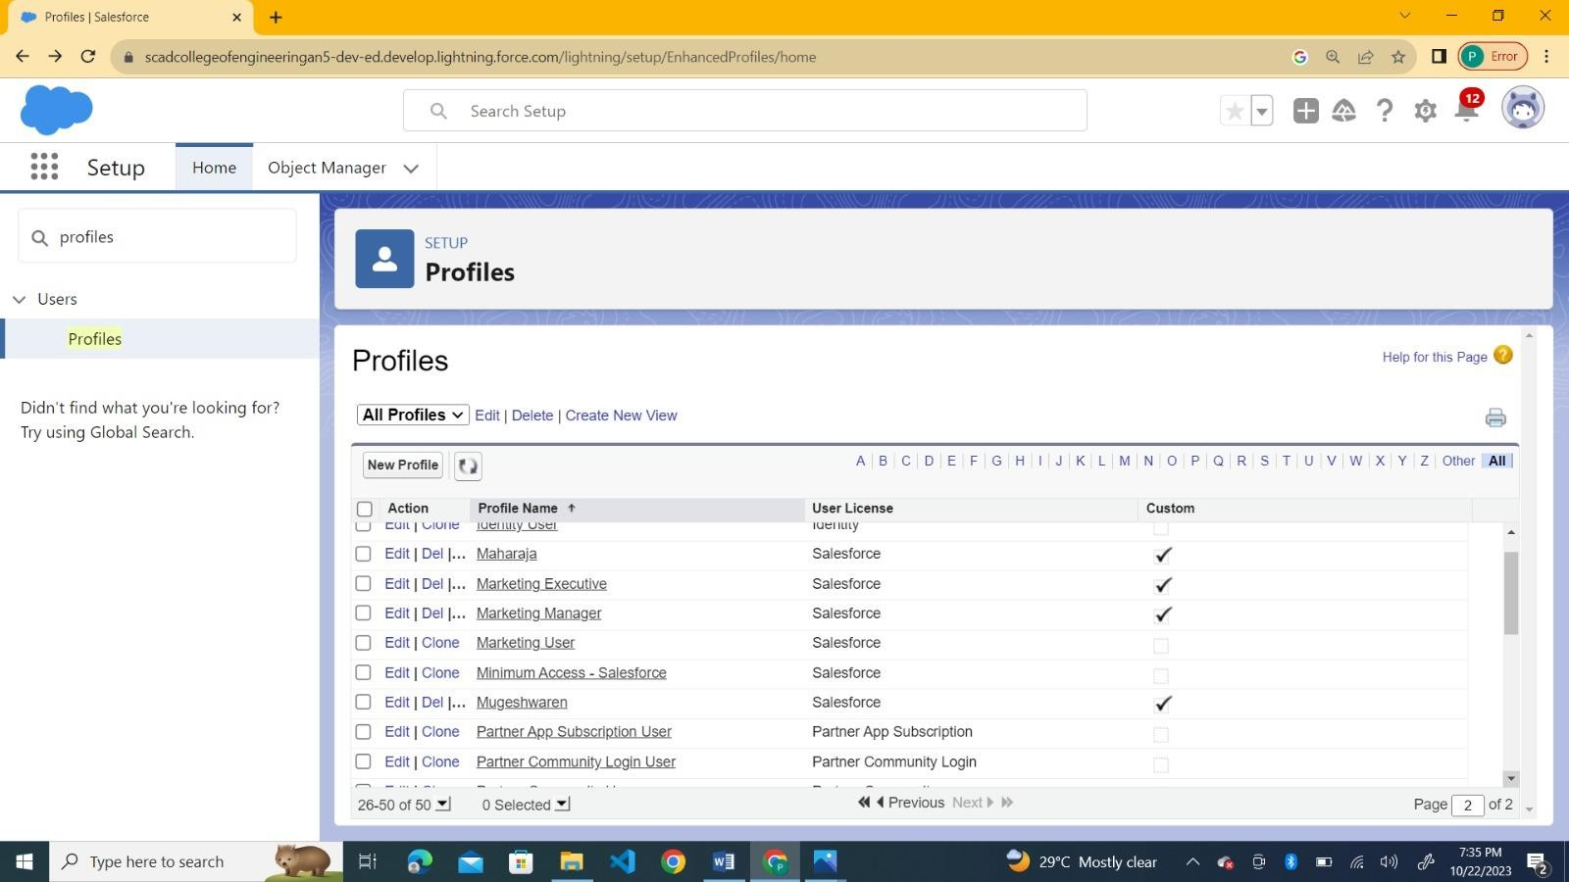
Step 6: Create the Profiles

Slide 12
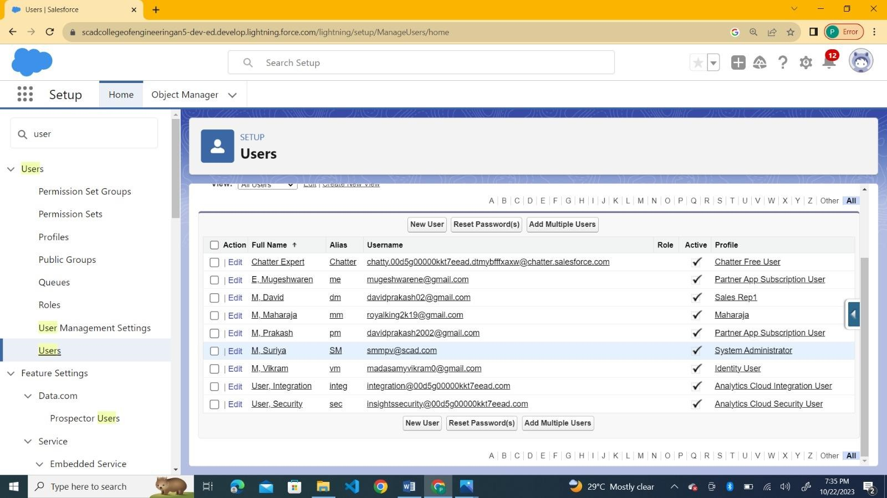
Step 7: Create the Users (Salesmanager, Marketing Executive,Sales rep1,rep2)

Slide 13
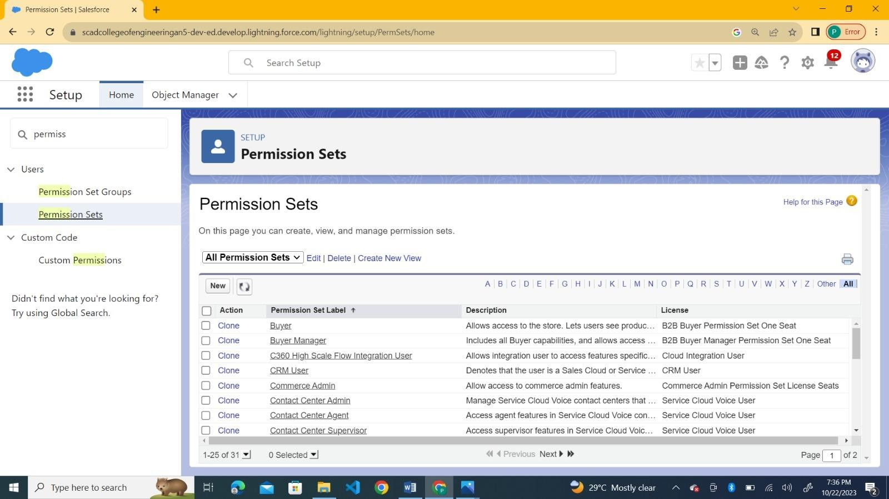
Step 8: Create the permission set for the users

Slide 14
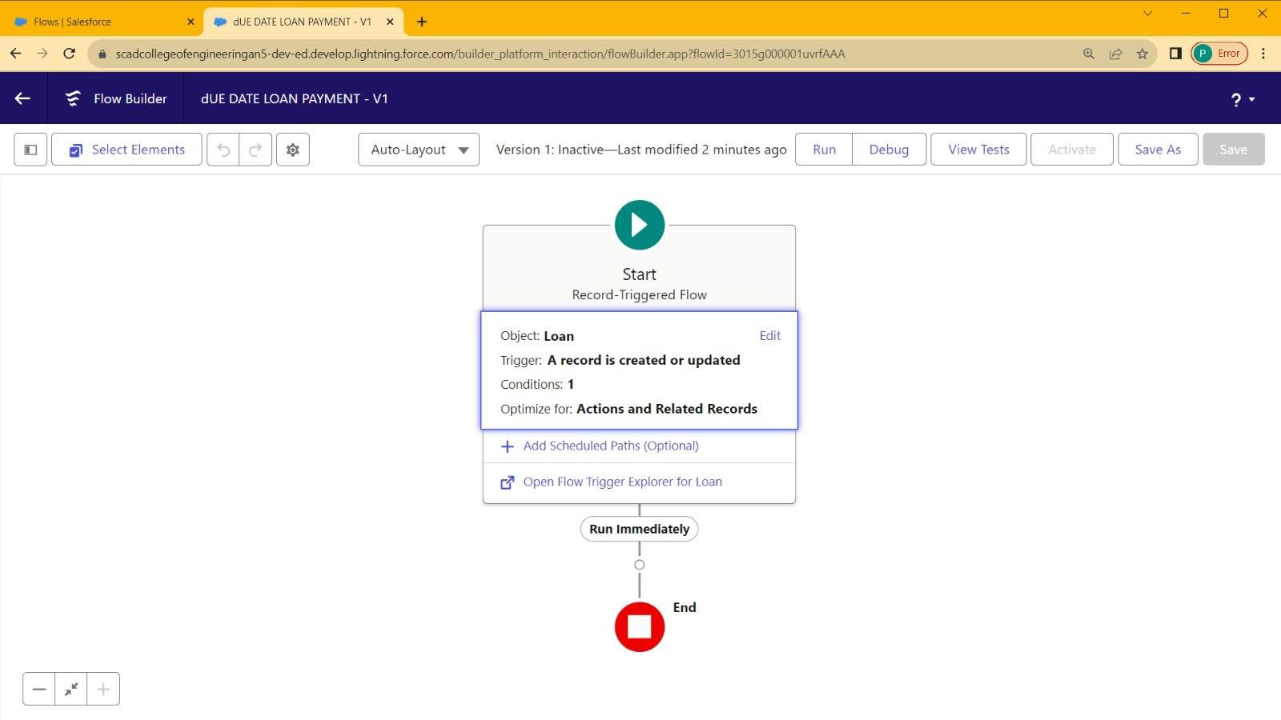
Step 9:Create A Flow

Slide 15
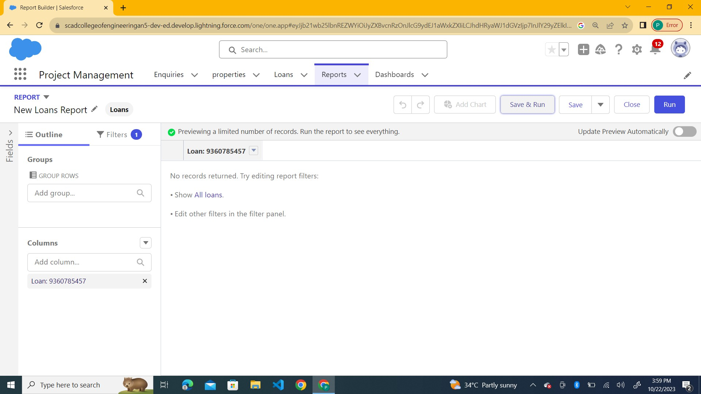
Step 10: Create Reports

Slide 16
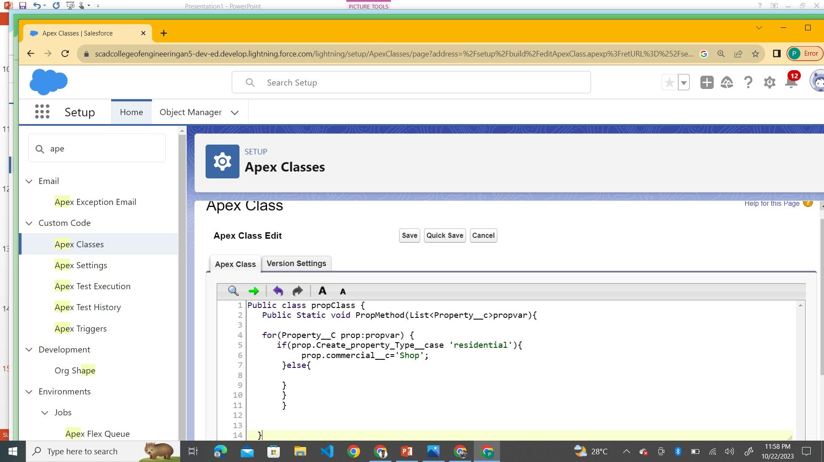
Step 11: Apex triggers and apex Class

